Slide 1

Bilibili - ( ° - °)つロ Cheers
Notes:
Bilibili
Introduce existence of the company

Slide 2


loading
Notes:
Just wait

Slide 3


With Reference to Bilibili, discuss how innovation and Ethics may influence marketing practices.
Notes:
State question

Slide 4
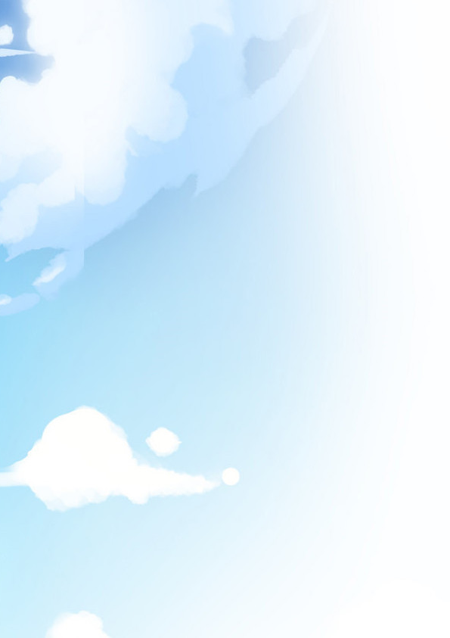

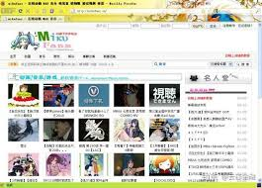

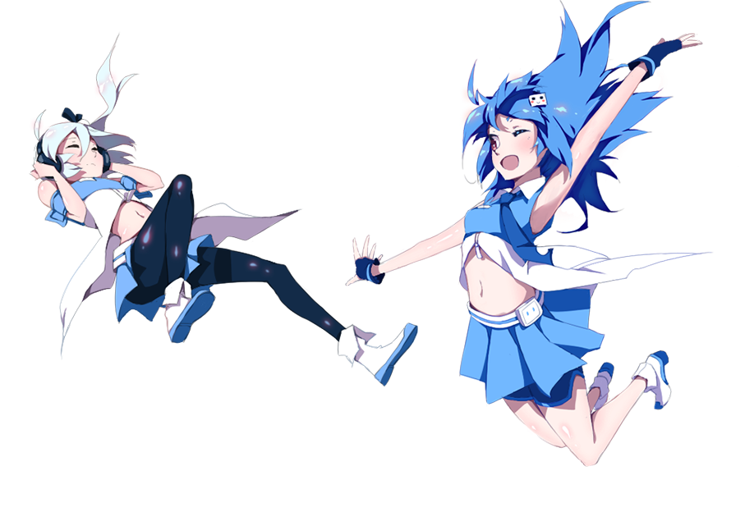

Background
Founded in 2009 June 26th
By ⑨bishi
Originally called Mikufans
Current CEO is Rui Chen
Changed name in 2010 January 24
22 & 33
Notes:
Founded by bishi
Originally called mikufans
CEO rui chen later joined
Changed name because of new anime
Have characters 22 and 33

Slide 5
Marketing
The faithfulness of consumers to a particular brand as shown by their repeat purchases irrespective of the marketing pressure from competing brands
A factor that differentiates a product from its competitors. A USP could be thought of as ‘what you have that competitors don’t’
Market growth
Target Market
Niche Marketing
Unique Selling Point
Brand Loyalty
Identifying and exploiting a small segments of a large market by developing products to suit it
The percentage change in the total size of a market (volume or value) over a period of time.
Focusing Marketing activity on particular segments of the market
Notes:
definition

Slide 6
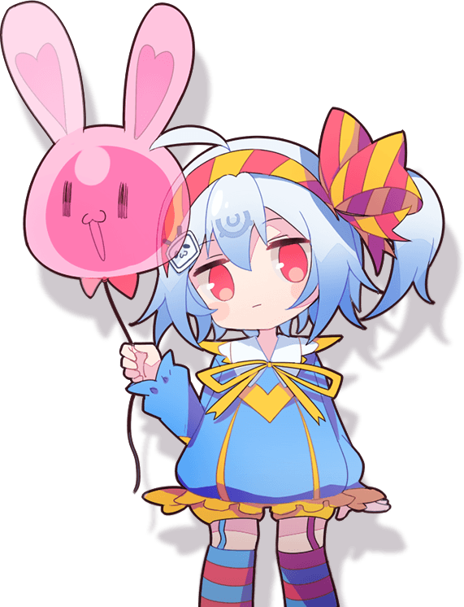

Innovation

Slide 7
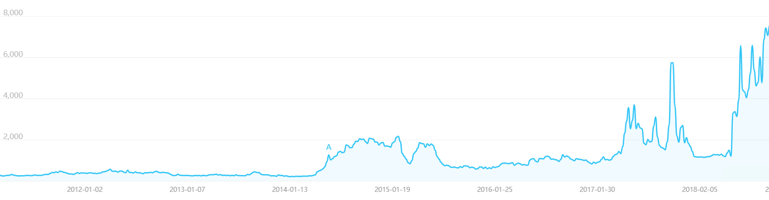
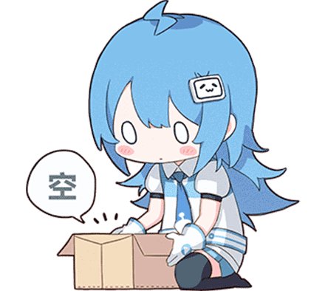
Target Market
Anime Community
Niche market
Small but growing
Notes:
Target market is anime community
Because bishi is interested in anime
Small at the time, but growing

Slide 8
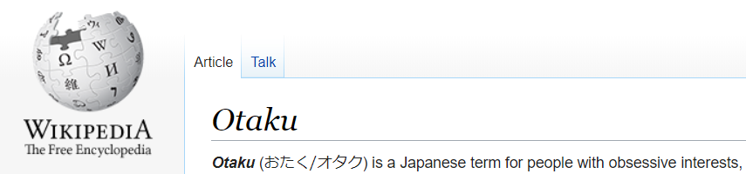
Otaku
Notes:
They are refere to them selves as “otaku”
Otaku are people who are overly obsessive with their interest
Often looked down by the society:

Slide 9
Place
Promotion
Product
Price
Notes:
Marketing mix: important factors in marketing

Slide 10
Ads
Notes:
Price
Do not ask for money
Take time to watch ad

Slide 11
















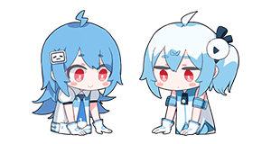
Ads
Mostly rely on ads
3-5 min un-skipable
＼(￣▽￣)／ NO ADS ON BIIBILI ＼(￣▽￣)／
Notes:
Most use ads
Youtube can skip, but ads in china are 3-5 minutes long
No ads for bilibili
Differentiation: different strategy
brand development: feel care, and attract game community

Slide 12
Ads
Mostly rely on ads
3-5 min un-skipable
＼(￣▽￣)／ NO ADS ON BIIBILI ＼(￣▽￣)／

Slide 13
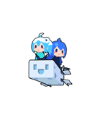
Notes:
Financial statement to show their reliance on games
Because why not

Slide 14




Internet
Target market
Easy to spread
Music
Digital art
E-commerce
Notes:
Location:
Located on internet
Not innovative at this point
Works well for target market
Innovation is spreading out
Not aimed to make profit
Attract people
Lead to use site
Watch video

Slide 15
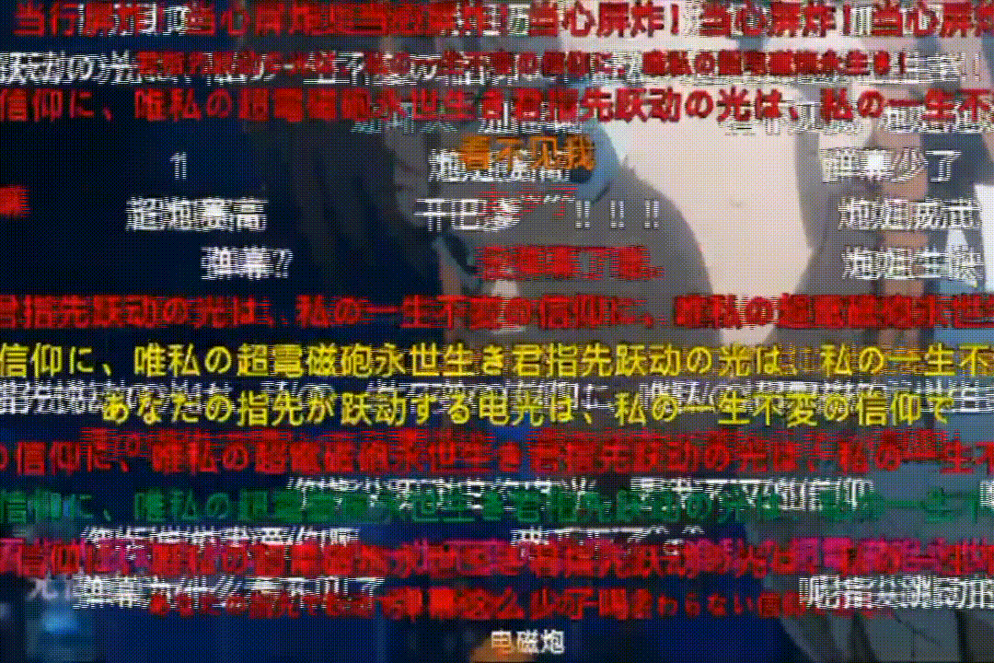
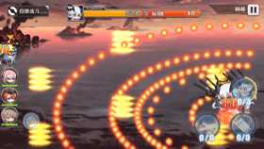
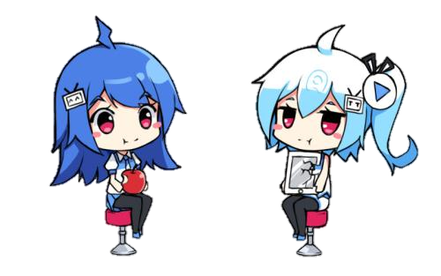
Dan-maku 弾 幕
guess they never miss huh
guess they never miss huh
guess they never miss huh
guess they never miss huh
guess they never miss huh
guess they never miss huh
guess they never miss huh
Hit or miss?
guess they never miss huh
guess they never miss huh
guess they never miss huh
Originally the bullets in games
Became comments of videos
guess they never miss huh
guess they never miss huh
guess they never miss huh
Notes:
Promtion:
Dan-maku are bullet in game
Become names for comment in video
Here is an example: hit or miss
Give birth to memes
Spread over internet
Viral marketing
Effective, but rely on customer maturity
Immature audience may spam and block screen
Below the line promotion

Slide 16

Registration system
Invitation only
Take test → member
Nicknamed the online exam
Became easier
Notes:
To compensate, have harsh registration system
Invitation at first, but then had a test
Very hard test, but got easier recently

Slide 17
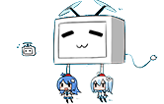
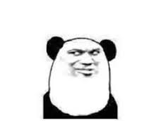
Benefits
Clean comments
Build community
Hard to join
Pride as a member
Notes:
Brand development: involvement lead to loyal to brand
Brand development: make member harder to obtain, thus give more value to brand
But block out a lot of potential customer

Slide 18
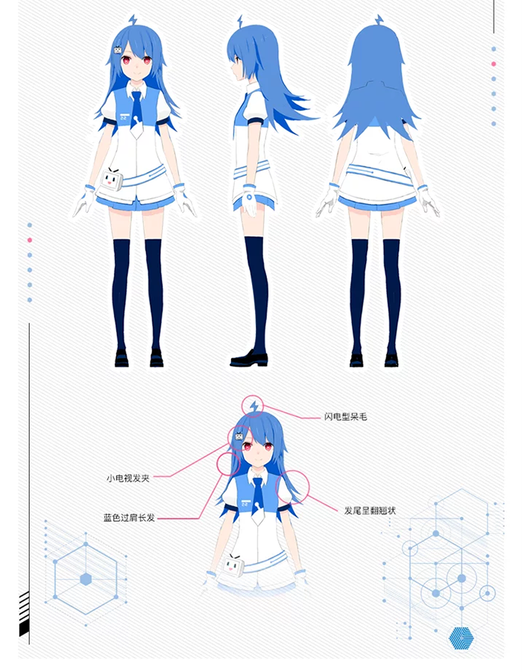
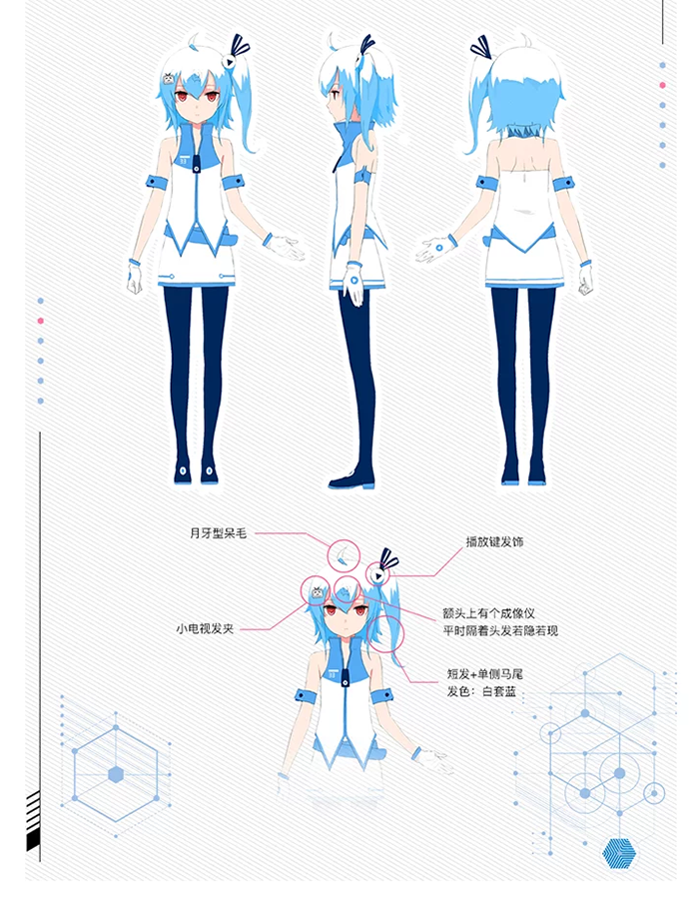
22 33
Notes:
Promotion

Slide 19
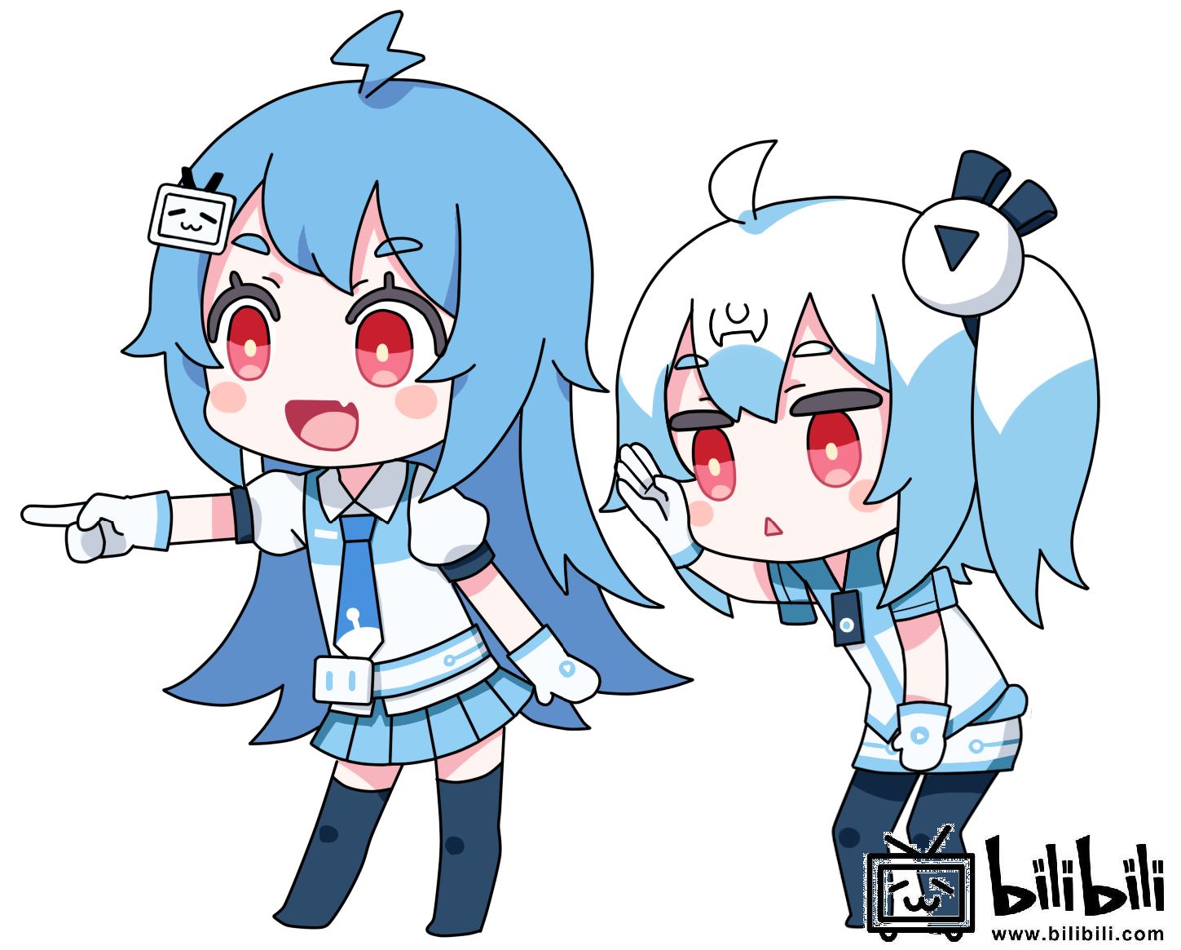
Anthropomorphism – 22 & 33
Characters of the company
Voted in 2010
Very popular
Fit target market
Notes:
2010/5/27 start, vote in 8/16
Brand development: differentiation from other and easy recognition
Anime community watch anime
Having anime turns them into an anime
Anime fans like them
Symbolize the brand like the four square of Microsoft, chewed apple of apple

Slide 20
22 & 33
Significant difference
More likely to use Bilibili
Create value in brand
Brand loyalty

Slide 21





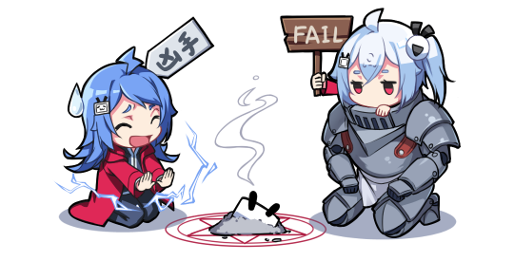



USP
Brand loyalty
Community – emotional connection
Monopoly of anime market
levels
Notes:
Unique selling point:
Brand loyalty talked about
It build and glorified the anime community
Dominance over other, almost monopoly
8,519,4583 posts, 945,105topics, 2,675,749 members in forum
Further increase brand loyalty by implementing levels
Brand loyalty motivate to get higher level
Positive feedback loop

Slide 22
USP
Brand loyalty
Community – emotional connection
Monopoly of anime market
levels
Notes:
8,519,4583 posts, 945,105topics, 2,675,749 members in forum

Slide 23




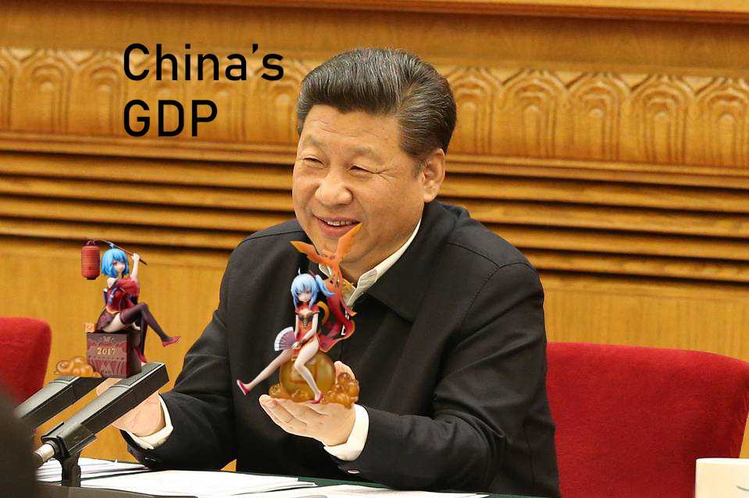

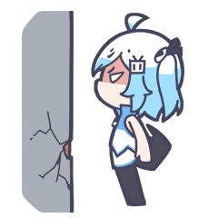

Viral marketing
Everyone talks about Bilibili
Spread with word
Memes created
Easily spread with 22 & 33
Pay to put up ads
Notes:
Viral Marketing: marketing with the use of social media
Establish community – more conversation about biibili
Memes created and spread by users
22 & 33 help spread as being symbol
Good brand development because lead to High brand awareness, brand loyalty, therefore have a high brand value – cause store to pay to put up ads
Good because holds one market firm, bad because loose a lot other market. Good for Bilibili because competitors are too big.

Slide 24
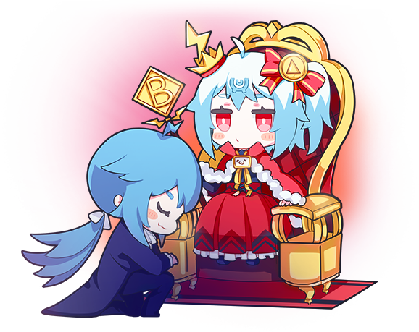
Ethics
Notes:
Ethics

Slide 25

Disappointed users
Hard → Easy
Uneducated comments
Discriminant
Swearing
Purposely start conflict
Sense of community
Notes:
Test moved from hard to easy
Lots of low age kids that do not know how to behave joined
Many uneducated comment
Ruin the old user’s sense of community
Disappointed – some left

Slide 26
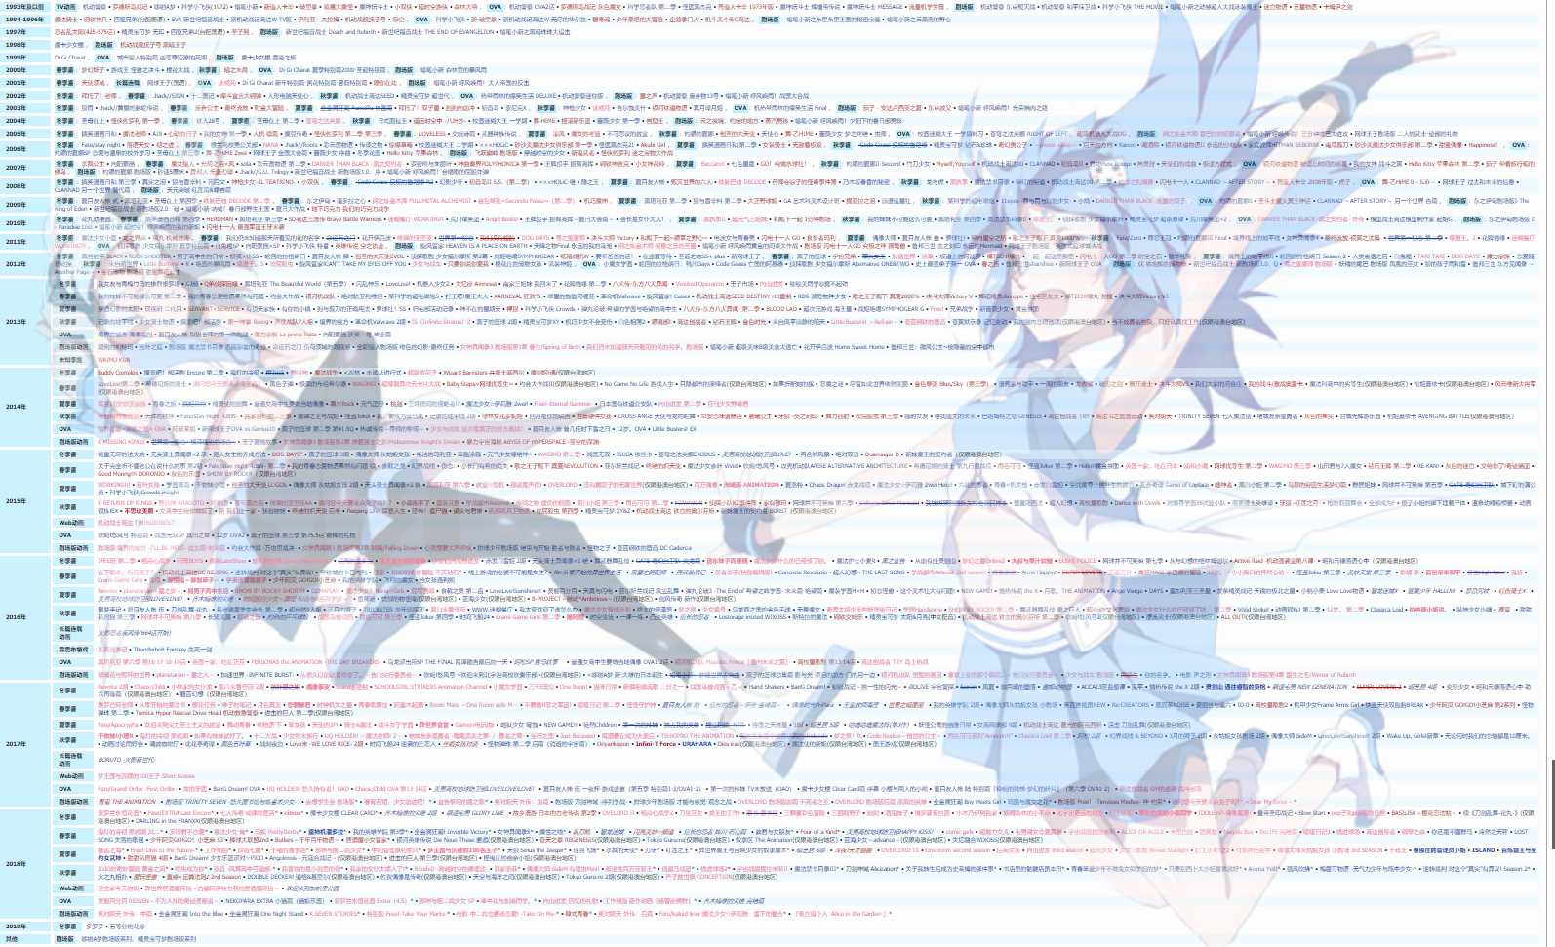
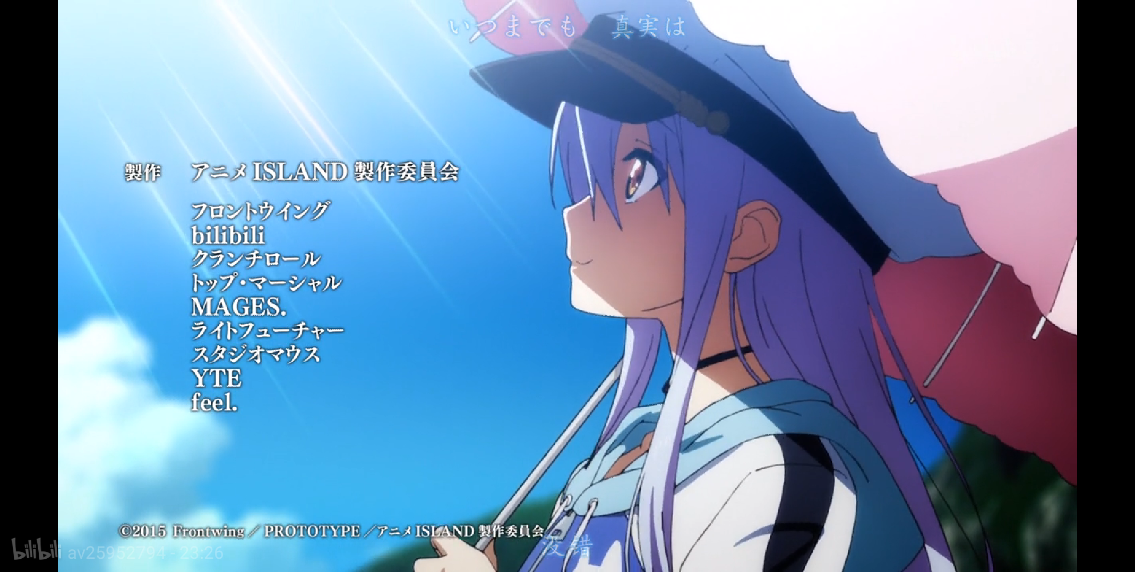







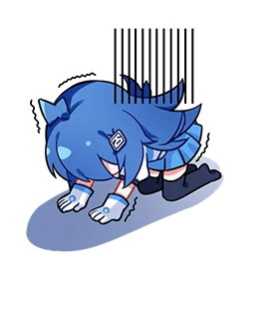
Copyright
Did not respect
Sued for 100 million dollars
Exposed uploaders in court
Start to value

Slide 27
Copyright
Did not respect
Sued for 100 million dollars
Exposed uploaders in court
Start to value

Slide 28



Treatment to users
Worsening
Abuse of power
Banning
Deleting comment
Not valuing privacy
Notes:
Originally have treated users fairly well
Worsened in treatment
Abusement of power
Mass banning of users
Deleting comment
Shown from recent event:
Bilibili refuse to ban a pedophilia streamer
Fan base got angry
Administrators deleted over 10 thousand comments and banned thousands of level 6 accounts
Not value privacy:
Exposing uploaders on court
Very committed users
Disappointed a lot of people

Slide 29

Treatment to users
Worsening
Abuse of power
Banning
Deleting comment
Not valuing privacy

Slide 30
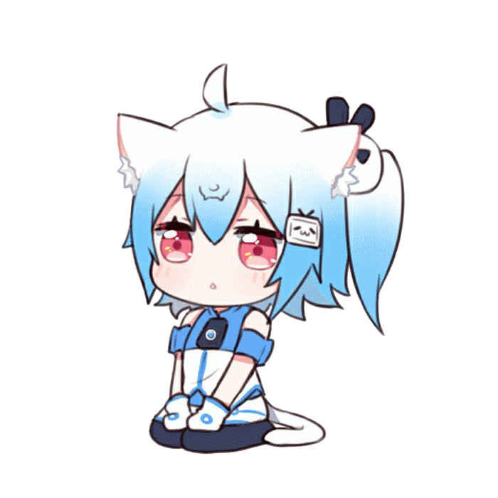
Unethical claims
Claim money spent on copyright
Spent on promotion and production
Lose loyal members
Notes:
If keep doing this: may live well for now, but not for long

Slide 31
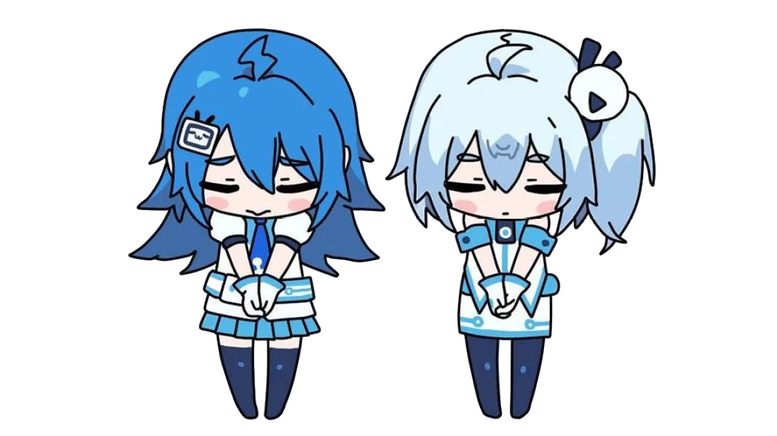
Why Oof
⑨Bishi was a part of the community
No need for market research
Rui Chen in charge
Less knowledge
Tradition of lack of research
Notes:
Market orientation

Slide 32
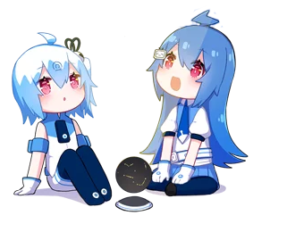
Stakeholders

Slide 33
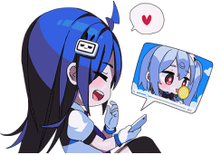
Anime community
Reason of creation
Biggest platform
Recent inflow
Old dedicated users leave
Notes:
External
Customer: value, quality, customer care
Community: involvement, truthful communication

Slide 34
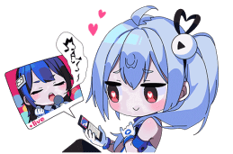
Uploaders
Spent a lot of time
Some are professional
Community means a lot
Notes:
Some internal and some external
Supplier: provide product and service
Employee (some): rate of pay, job security, respect, recognization

Slide 35
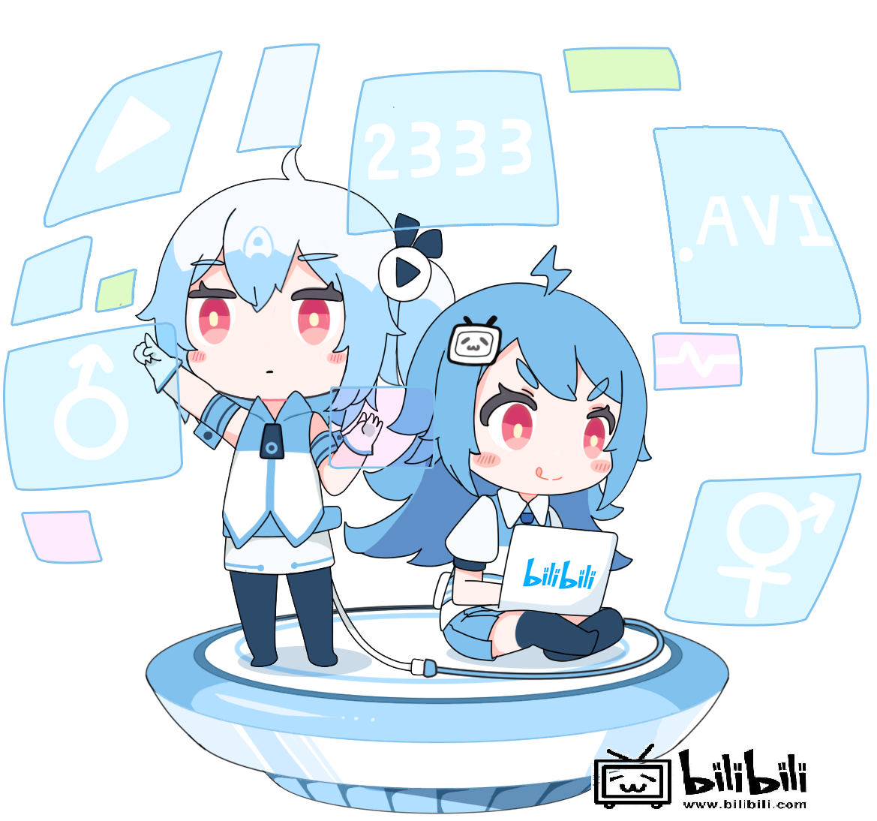
Anime producers
Large part of their income
Buys new anime every year
Part of production
Notes:
External
Supplier: provide supply
Community: involvement,

Slide 36

Shareholder & Employee
Income rely on company
Have responsibility
Most care a lot about company
Notes:
Internal
Employee: rates of pay, job security, respect, recognization
Investor: return income
Owners: profitability, longevity, market share, growth, intention

Slide 37

Target now
Want anime fans
Want normal people

Slide 39


Slide 40
Reference
www.Bilibili.com
en.Wikipedia.org (screen shot)

